Slide 1
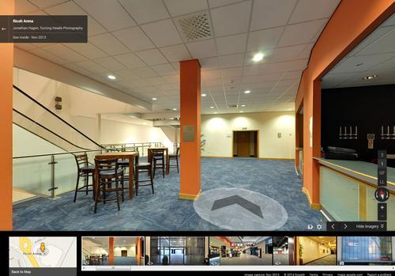
AUGMENTED REALITY INDOOR NAVIGATION APP
TEAM BLUEPRINTS
Justus Karenzi
Sudi Nsengiyumva
Jeremy Fischer
Jordan Ziegler
Dylan Shanahan

Slide 2
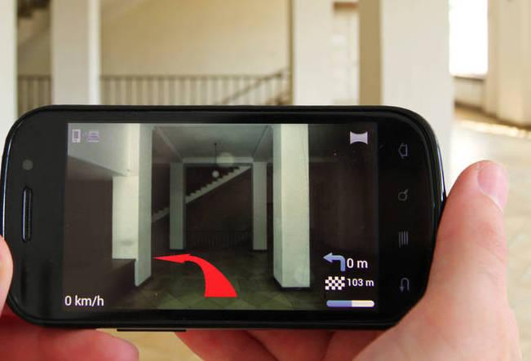
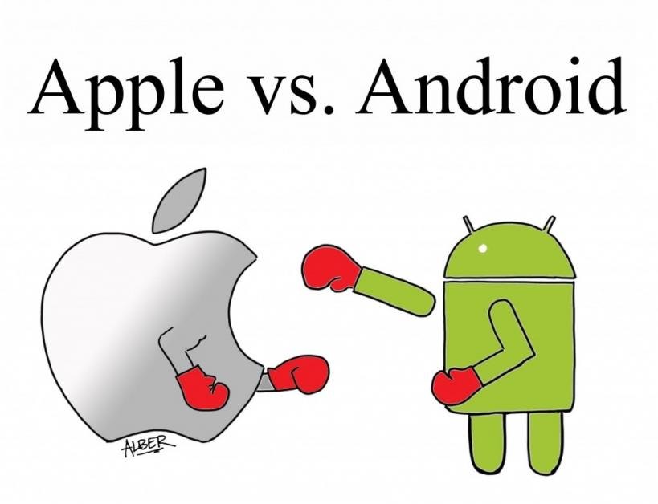

INITIAL PROBLEM STATEMENT
The App will rely on Augmented reality

Slide 3



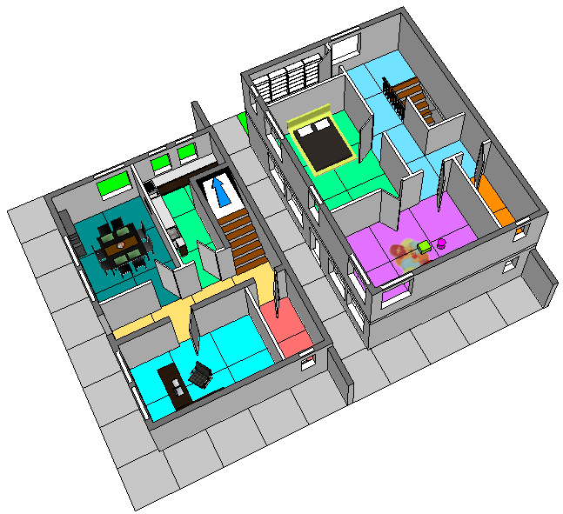
CLIENT INTERVIEW
Hello Navi is a possible resource for Augmented manipulation
The team is free to choose between IOS and Android
The Application should be user friendly
Inserting a map of the building and include a 3D guide from room to room

Slide 4
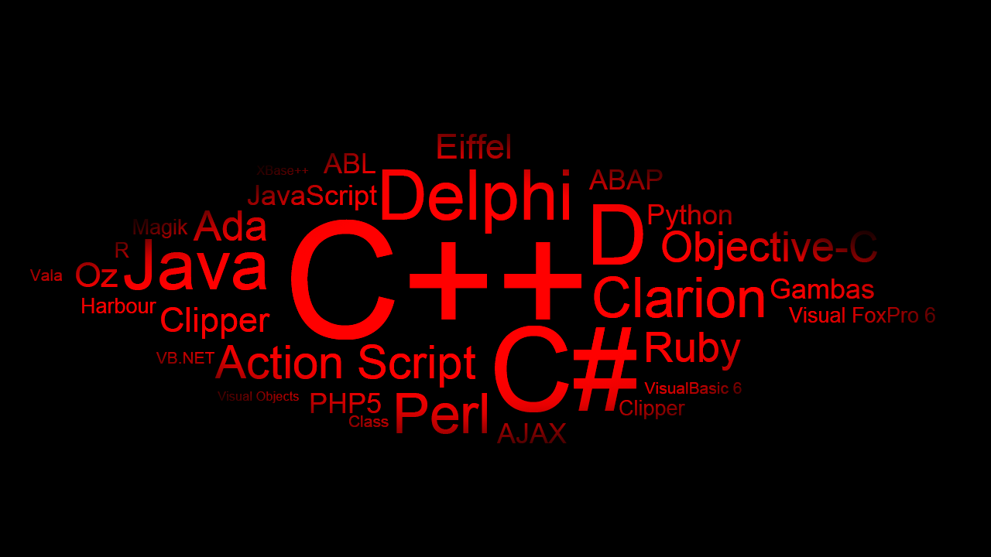
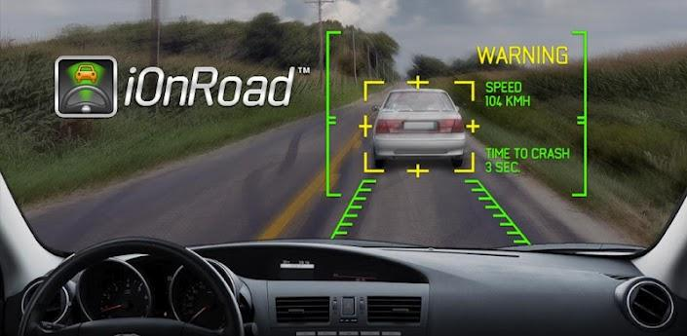

BACKGROUND RESEARCH AND RELEVANT TECHNOLOGY
Available technologies for designing navigation applications
iOnRoad is a free augmented reality driving safety app

Slide 5
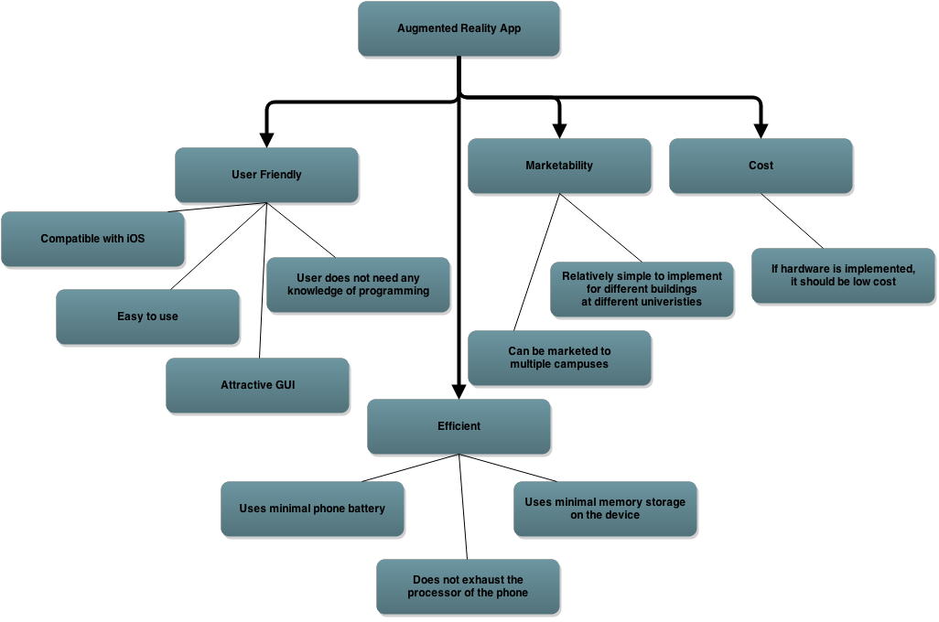
OBJECTIVES TREE

Slide 6
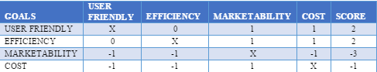
COMPARISON CHART
-1: The goal in the row is less important than the goal in the column.
0: The goal in the row is equally important to the goal in the column.
1: The goal in the row is more important than the goal in the column.
x: Cannot compare goal relative to itself

Slide 7


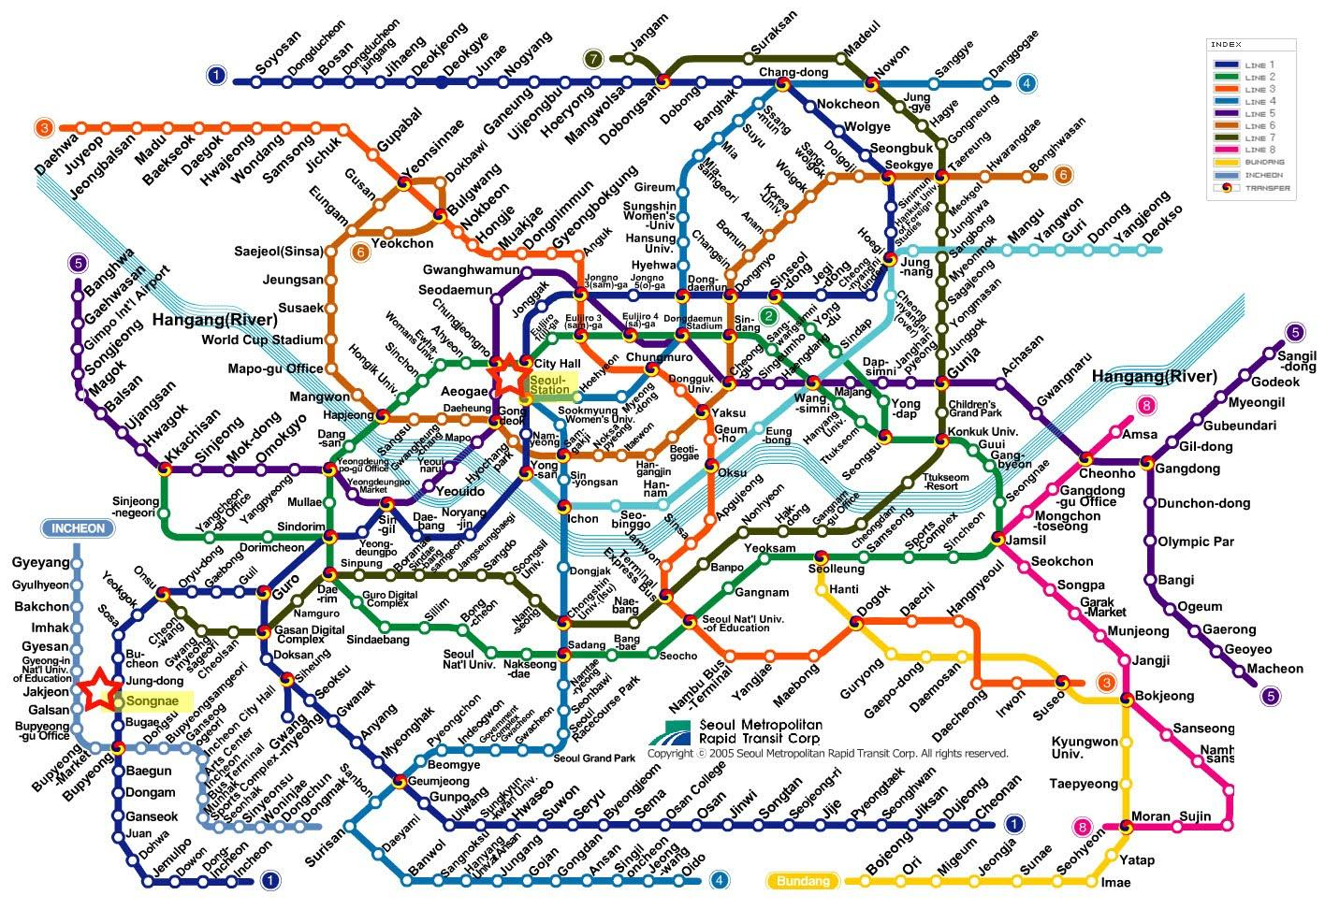
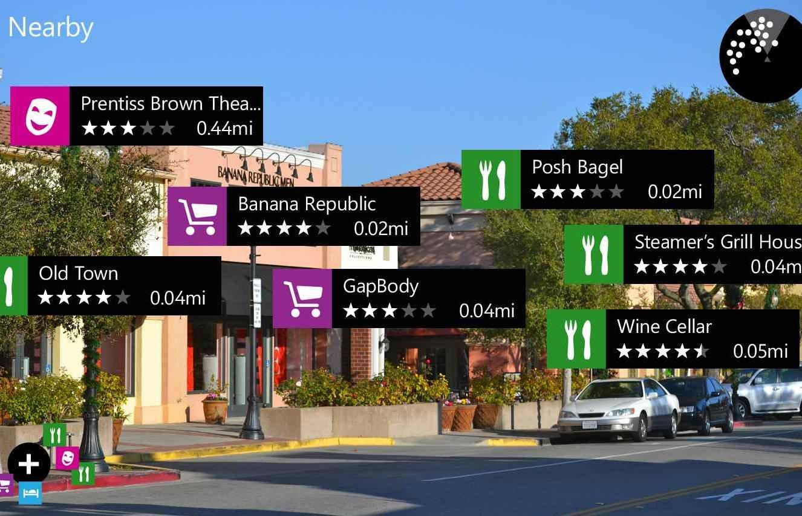
PROBLEM DEFINITION

Slide 8
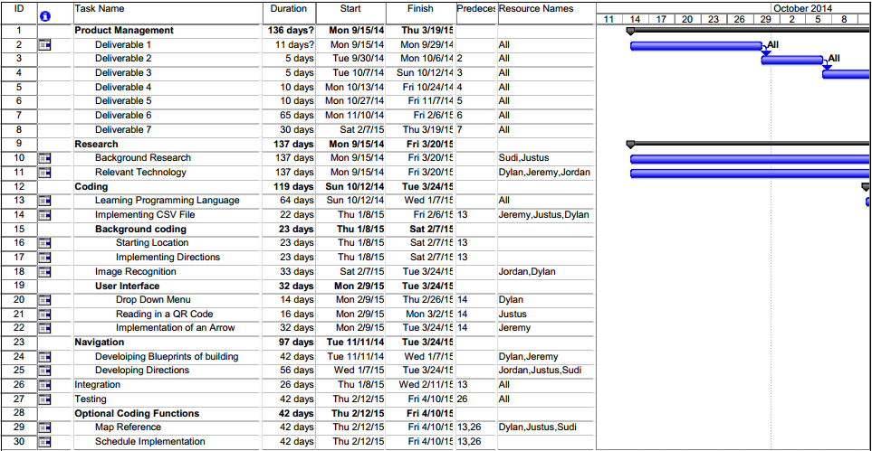
Gantt Chart

Slide 9
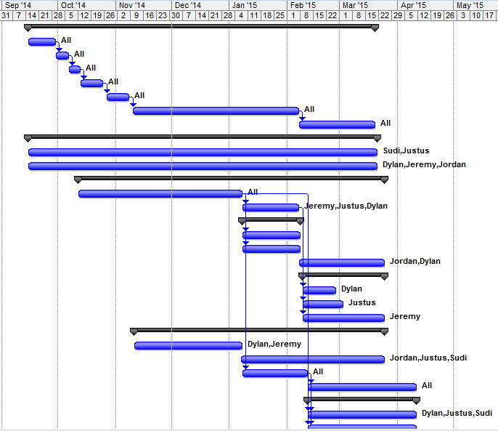
Gantt Chart

Slide 10

CONSTRAINTS ARE THE DESIGN SPECIFICATIONS AND LIMITS IMPOSED BY THE ENVIRONMENT AND THE CLIENT.

Slide 11
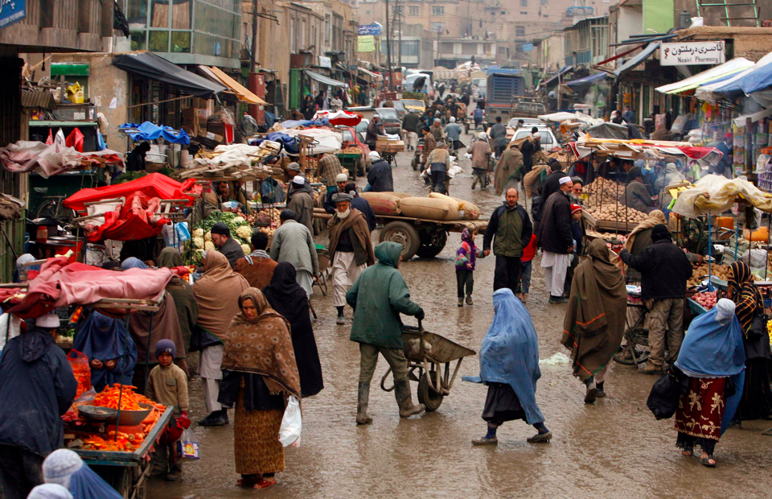
MARKETING REQUIREMENTS ARE THE REQUIREMENTS RELATED TO MAKING OUR PROJECT MARKETABLE.
- Efficiency
- Time Constraints
- Budget Constraints
- Software Constraints

Slide 12
Efficiency is how effective our project is compared to the different costs the user pays
Battery Life
Memory Storage
Processor Allocation

Slide 13
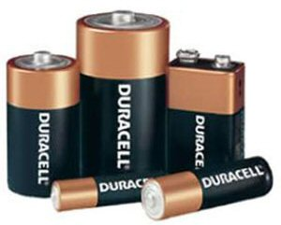
Battery Life expended through this application should not be excessive.
1% per minute

Slide 14
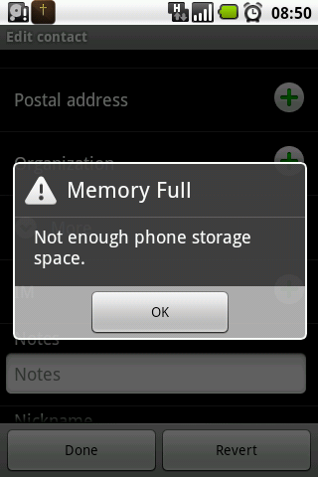
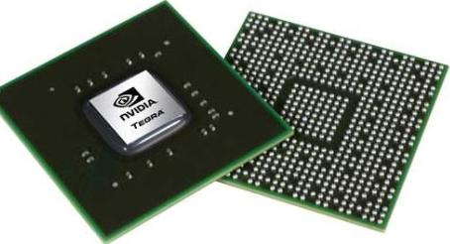
Memory storage and processor requirements should not be extreme.

Slide 15


Time and budget constraints are also a factor.
Project Completion required by April 15 2015.

Slide 16
Software constraints are the main requirements of the project
Drop Down menu
CSV files
Left, right, straight direction
Image referencing
Starting Location

Slide 17
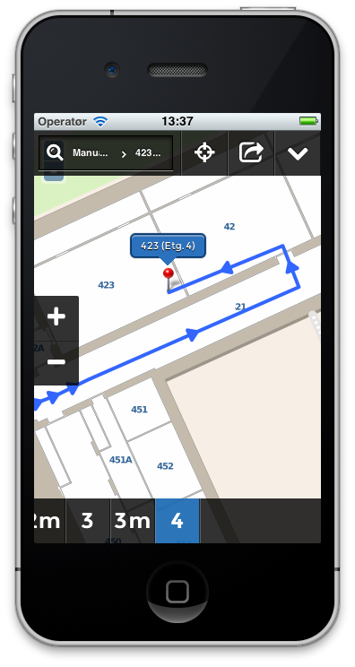
Also optional software requirements
Map Reference
Schedule implementation

Slide 18
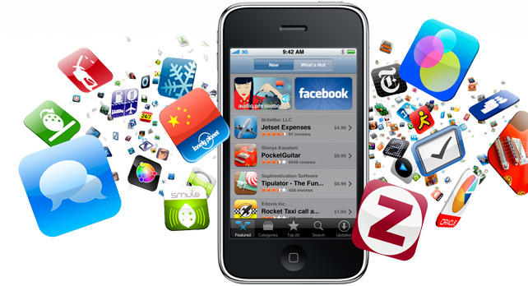


BECAUSE OUR PROJECT IS AN APPLICATION WE FOCUSED OUR ATTENTION FOR STANDARDS ON SOFTWARE AND MOBILE APP DEVELOPMENT.

Slide 19
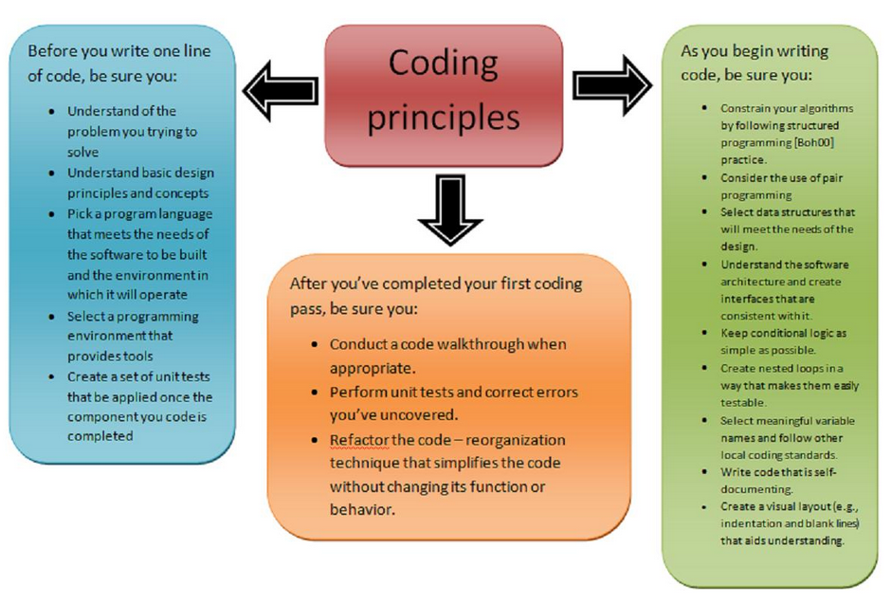
WE FOUND GENERAL CODING PRACTICES THAT ARE UTILIZED IN THE SOFTWARE COMMUNITY.

Slide 20
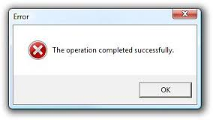
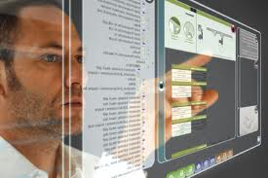
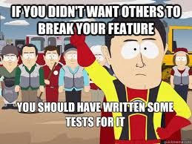
WE FOUND IEEE STANDARDS FOR SAFETY, TESTING, AND INFORMATION TECHNOLOGY.
IEEE 1228 – Software Safety Plan
IEEE 29119 – Software Testing
Section 508 Standards
• software applications and operating systems
• web-based information or applications
• telecommunication products
• video and multimedia products
• self contained, closed products (e.g., information kiosks, calculators, and fax machines)
• desktop and portable computers

Slide 21
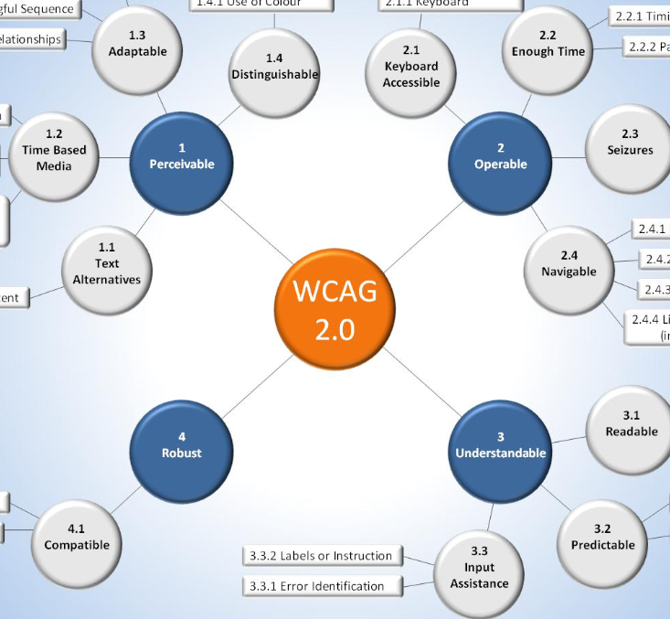
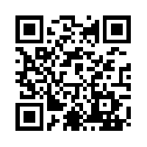

THERE WERE ALSO STANDARDS FOR WEB CONTENT, QR CODES, AND CSV.
Web Content Accessibility Guidelines
ISO/IEC 18004:2000 & 2006
Defines QR code Characteristics and Formats
CSV – RFC 4180

Slide 22


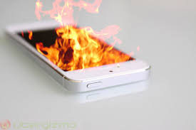
MARKETING REQUIREMENTS
1. The program should show users where they need to go.
2. The program should be user friendly and easily operated.
3. The program should not strain the user’s hardware.
4. Optional functionality
User Friendly.
Provides directions.
Does not strain hardware.

Slide 23
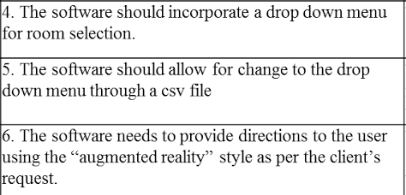
REQUIREMENTS SPECIFICATIONS
Marketing Requirements | Engineering Requirements | Justification
3 | 1. The battery should not drain faster than 1% per minute | Despite relatively short periods of use, the user should not experience a quick depletion of their battery while using this application.
3 | 2. The app should not take up more than 256MB of space on the hardware device. | The program will be designed to store most data on the hardware device, but will limit the space it takes up so that the user is not inconvenienced due to the large space demands of this program.
3 | 3. The processor of the hardware device should not be taxed by the program and create hardware complications. | This is tied in with the battery use and the desire not to inconvenience the user with the application use. The program should not be developed in inefficient manners which are unkind to the user’s hardware.
2 | 4. The software should incorporate a drop down menu for room selection. | The user needs to be able to quickly and efficiently choose where they want to go.
2 | 5. The software should allow for change to the drop down menu through a csv file | The ability to rename the rooms they frequent regularly is an important function for ease of use. It is convenient to be able to rename rooms based on what you remember them for, rather than what their actual titles are.
1 | 6. The software needs to provide directions to the user using the “augmented reality” style as per the client’s request. | This is the fundamental of the program. The program needs to show the user where they need to go and how to get there. The easiest method for the user is to show them the world and which direction they need to go through the camera.
1,2 | 7. The software needs to be able to recognize images. | The bare minimum software system needs to recognize and utilize images to determine location and arrow directions.
1 | 8. The software should recognize where the user is starting from. | The program recognizes where the user starts out and from there is able to guide the user to their destination.
1,2 | 9. The software will provide a map layout of the building.* | The program needs to show the user a top down map of the area and the directions they will be taking.
4 | 10. The software will be able to include the user’s schedule into the program and use it for directions.* | The schedule can optionally be implemented for the program to determine where the user needs to go and when they need to go there to create better ease of use.

Slide 24

Deliverable 4 is the Concept Generation and Selection.

Slide 25

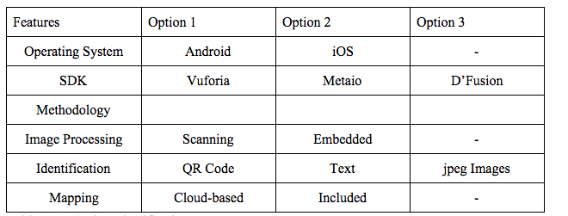
Concept Generation Chart
SDK | Vuforia | Metaio | D’Fusion
Brainstorming portion of the project

Slide 26
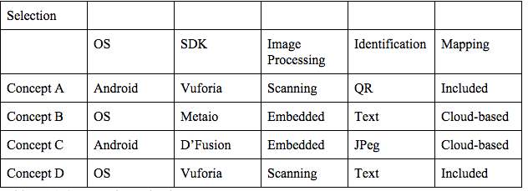
We combined the options brainstormed in different ways to generate concept ideas.

Slide 27
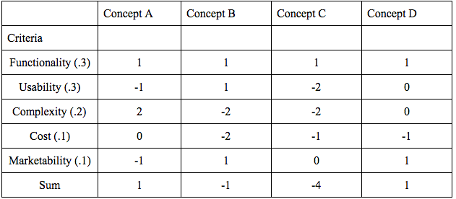
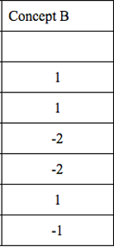
The next step was to score the concepts based on objectives.

Slide 28
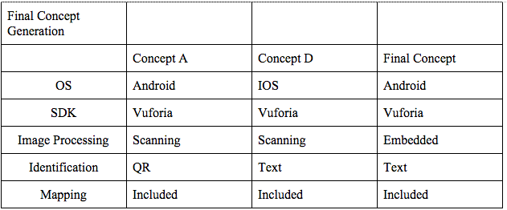
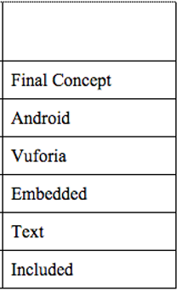
Because of the tie, we generated a final concept based on both of them combined.

Slide 29
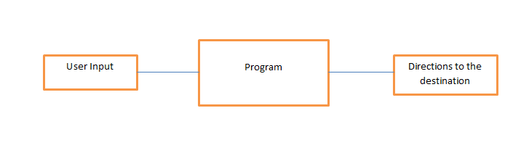
For the overall architecture we started with a Level 0 Model.
Figure 5.1.1 - Level 0 Software Architecture Design
Detailed Architecture

Slide 30
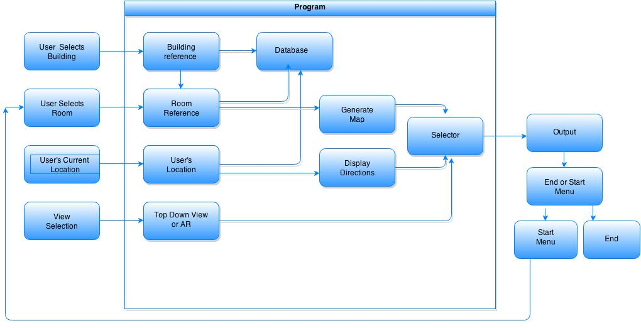
Next we expanded on our Level 0 Model to make a more in depth analysis of our app.
Figure 5.1.2 - Level 1 Software Architecture Design
Detailed Architecture

Slide 31
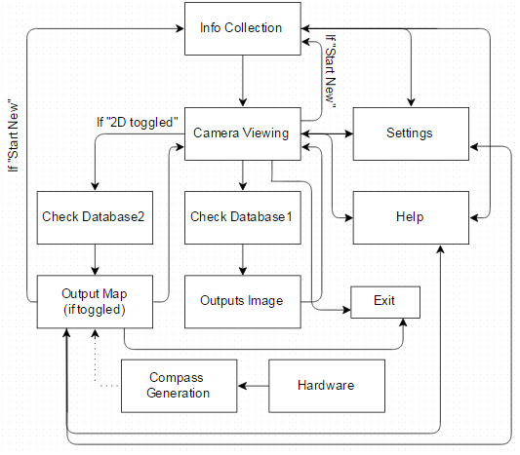
Finally we created a Flow Chart to describe how the App develops.
Figure 5.2.1 - Augmented Reality App Flow Chart

Slide 32
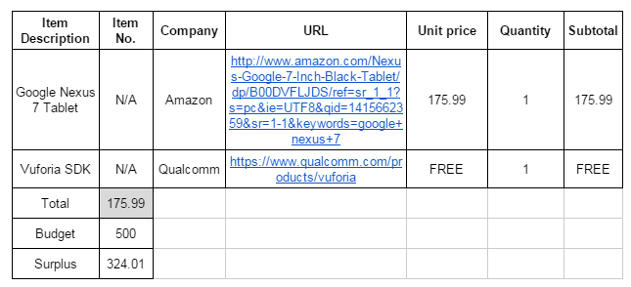
We created a Bill of Materials (BOM) to view the current draw from our budget.
Table 5.13: Capital Equipment - Bill of Materials (BOM)
Detailed Budget

Slide 33
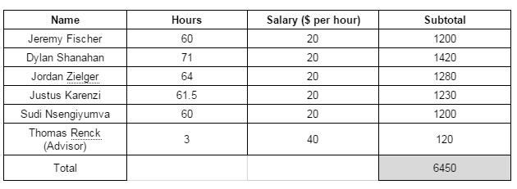
We also created a payroll to show the cost of designing the App.
Table 5.14: Payroll
Detailed Budget

Slide 34
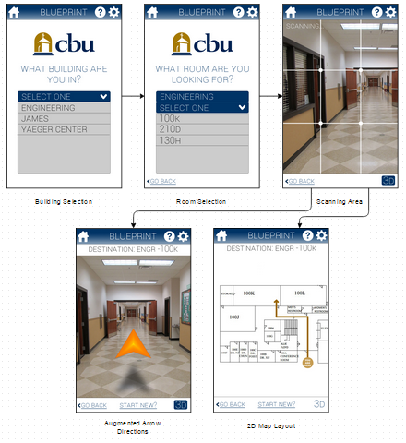
User Interface Flow Diagram

Slide 35

QUESTIONS?

